Slide 1
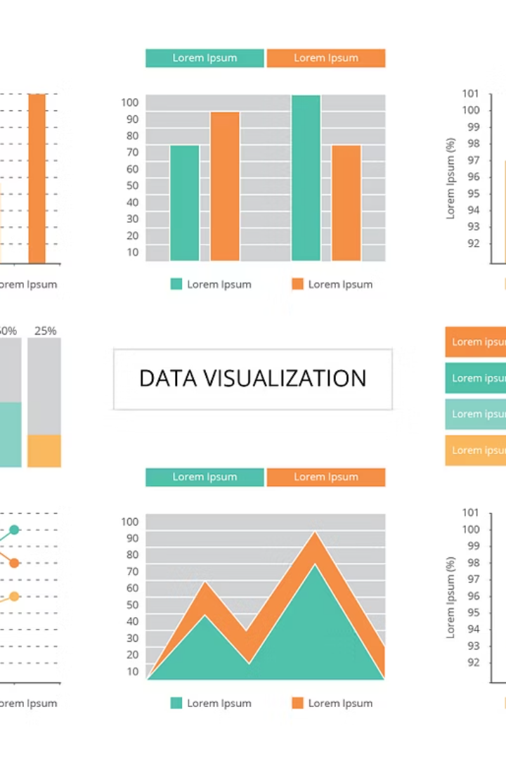
Telling Stories with Data Visualization Using Python
Presented by: Muhammad Fahad Bashir

Slide 2

Agenda
🔹 Introduction to Data Visualization
🔹 Overview of Python Libraries
🔹 Why Plotly ?
🔹 Creating Charts with Plotly
🔹Exporting & Sharing Visuals
🔹 Live Explanation of charts & Figures
🔹 Q&A + Wrap Up

Slide 3
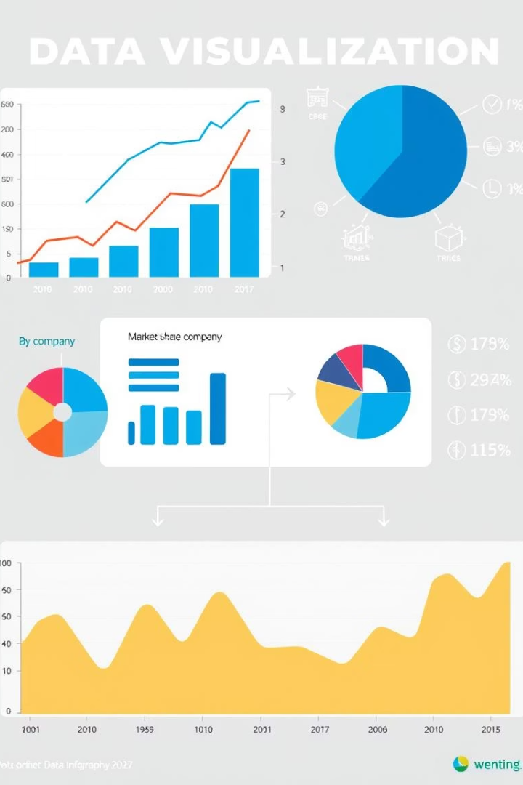
What is Data Visualization?
Definition
Importance
Visual representation of data to communicate information effectively.
Transforms complex data into understandable insights.
Key Quote
A picture is worth a thousand rows of data.

Slide 4

Why Data Visualization Matters
Real-World Use Cases
Storytelling with Data
From Raw Data to Insight
Healthcare, finance, marketing, and more rely on visual data.
Visuals make data relatable and persuasive.
Visuals reveal patterns and trends hidden in raw numbers.

Slide 5
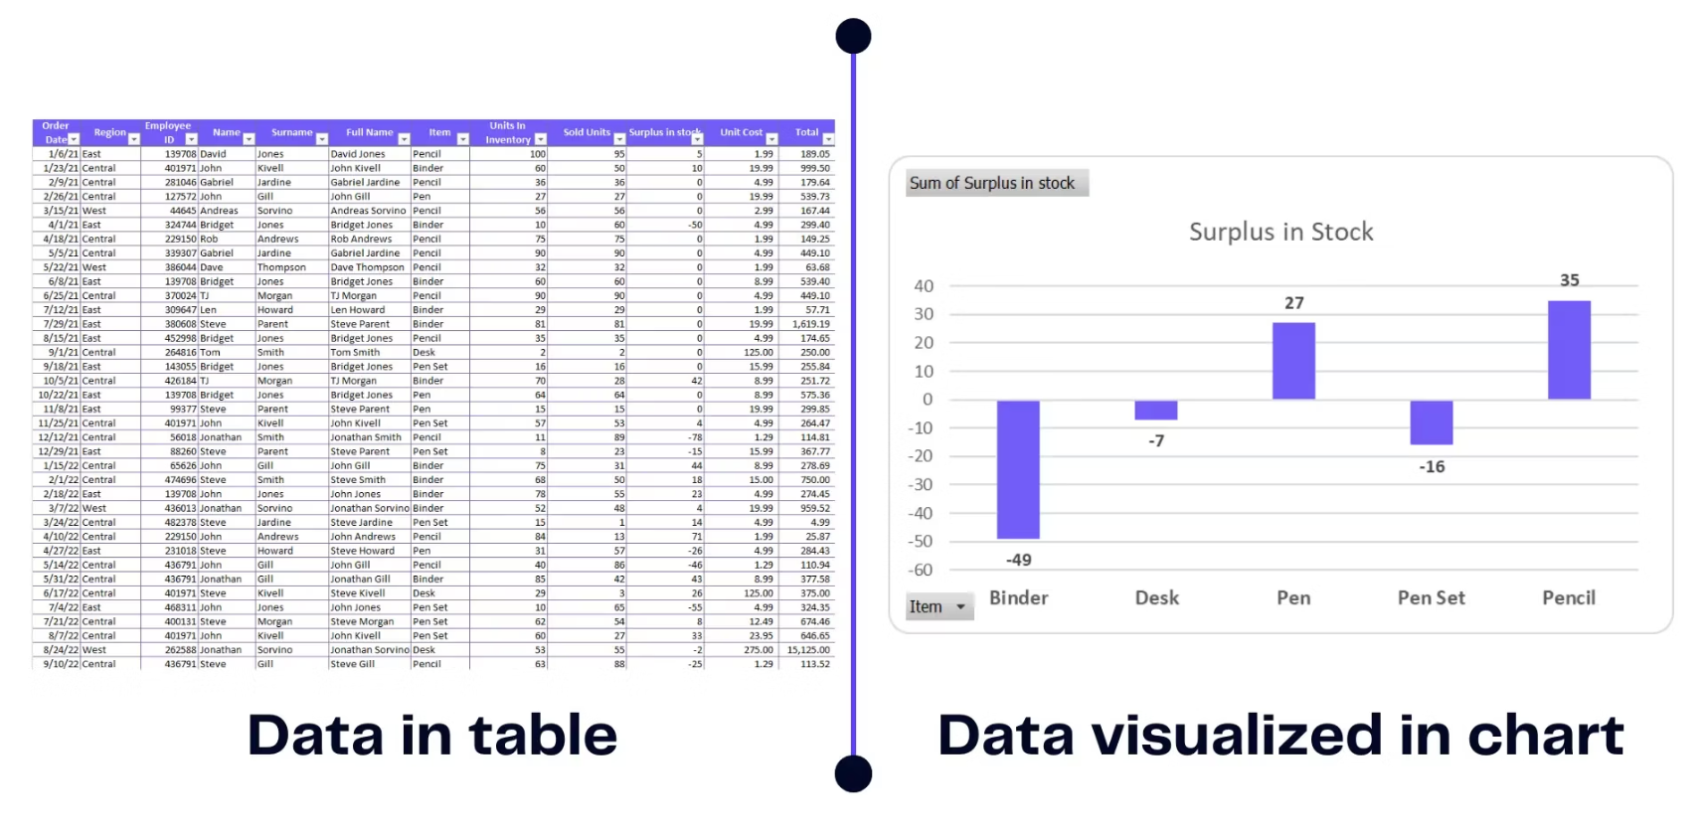
Data in Table vs Data In Chart

Slide 6


Python Libraries for Data Visualization
Matplotlib
The foundation for static plots and customization.
2
Seaborn
Statistical visuals built on Matplotlib with style.
Pandas
Quick plotting integrated with data frames.
4
Plotly
Interactive, animated, and beautiful charts.
Others
5
Altair, Bokeh, Folium for specialized visualizations.

Slide 7
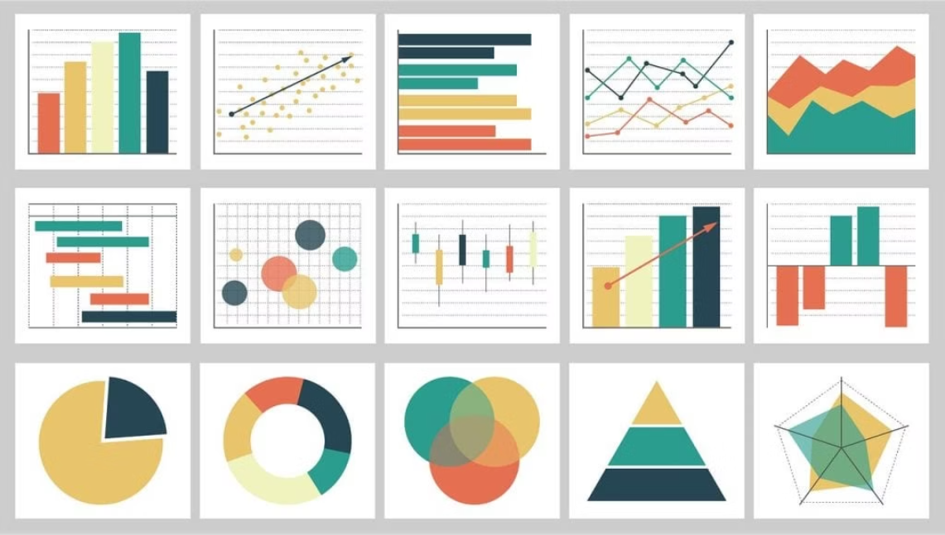
Why Choose Plotly?
Interactivity
Built-in Themes
Animation Support
Hover, zoom, and filter data dynamically.
Multiple elegant styles for quick beautification.
Create engaging dynamic visualizations easily.
Pandas Integration
3D & Geo Plots
Smooth workflow with Pandas data structures.
Supports 3D charts and geographic mapping.

Slide 8
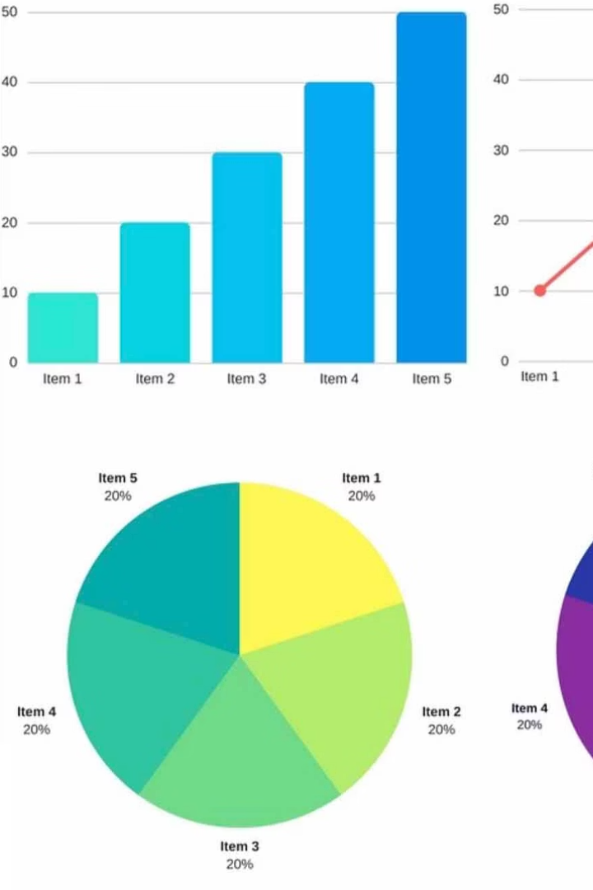
Types of Charts You Can Create
Line
Bar
Pie
Scatter
Box
Heatmap
Bubble
3D Plot
Sunburst / Treemap
Choropleth Maps
Animated Charts

Slide 9





Plotly in Action – Hands-on Coding
Import Data
Load datasets like Gapminder, Titanic, or Penguins.
Create Charts
Build simple and complex visualizations seamlessly.
Add Animation
Enhance storytelling with smooth animations.
Export Options
Save visuals as images, HTML, or video files.

Slide 10
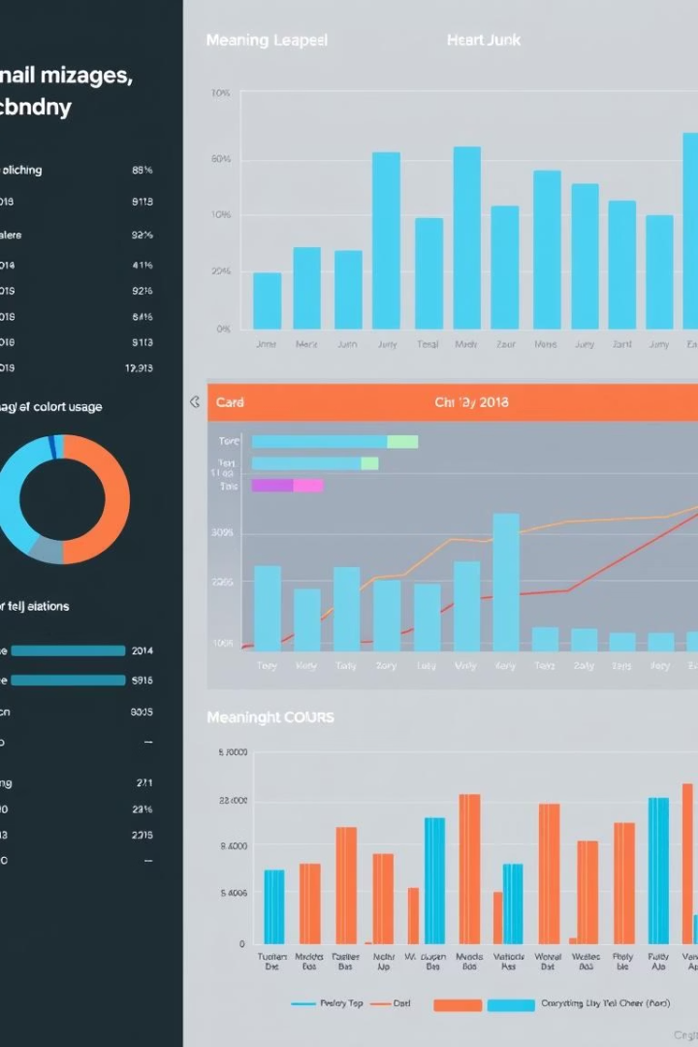
Tips for Effective Data Storytelling
Right Chart
Choose chart type to suit the message.
Reduce Clutter
Minimize unnecessary elements for clarity.
Use Color Meaningfully
Leverage color to highlight important data.
Label Axes Clearly
Ensure axis labels explain the data precisely.

Slide 11
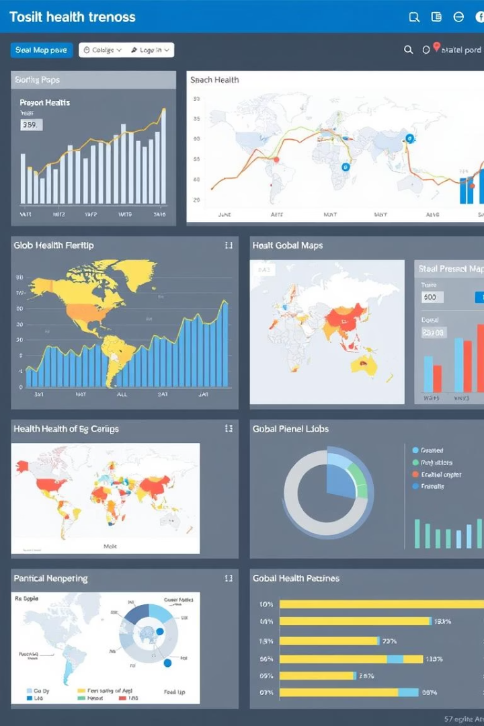
Hands on Practise : Visualizing some important Charts
Load Data
Example titanic, penguins,etc.
Build Visuals
Create maps and animated line charts.
Share Insights
Present findings with interactive dashboards.

Slide 12
Exporting & Sharing Visuals
Save as PNG or JPG
Export as HTML
Convert Animation to GIF/MP4
For static image sharing and presentations.
Maintain interactivity for web use.
Share engaging, portable animated visuals.

Slide 13
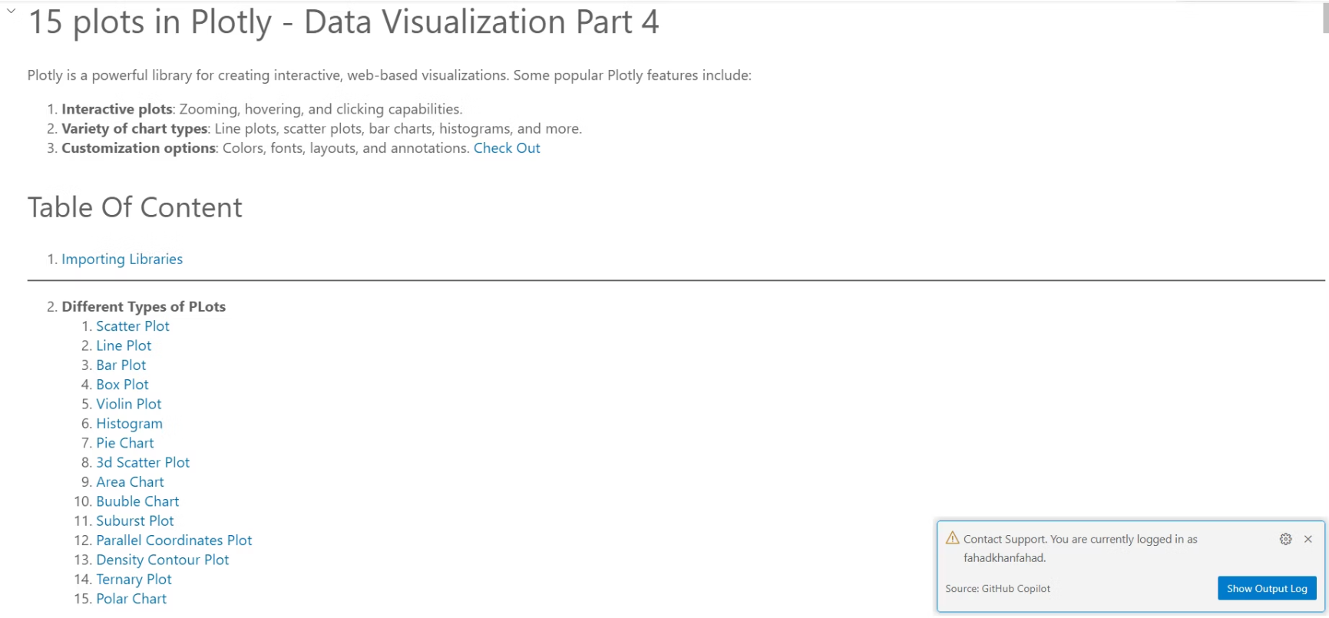
Let's Start

Slide 14




Thank You!
We appreciate your time and interest in data visualization.
Feel free to ask questions or explore Plotly further.
Stay Curious
Keep experimenting with charts and data stories.
Explore Plotly
Discover more interactive and animated visualizations.
Connect and Share
Use visuals to communicate insights effectively.

